Slide 1
Geant4 Simulation: Compton Profile Mapping
Md Rahman
Advisor
Professor Dongming Mei

Slide 2
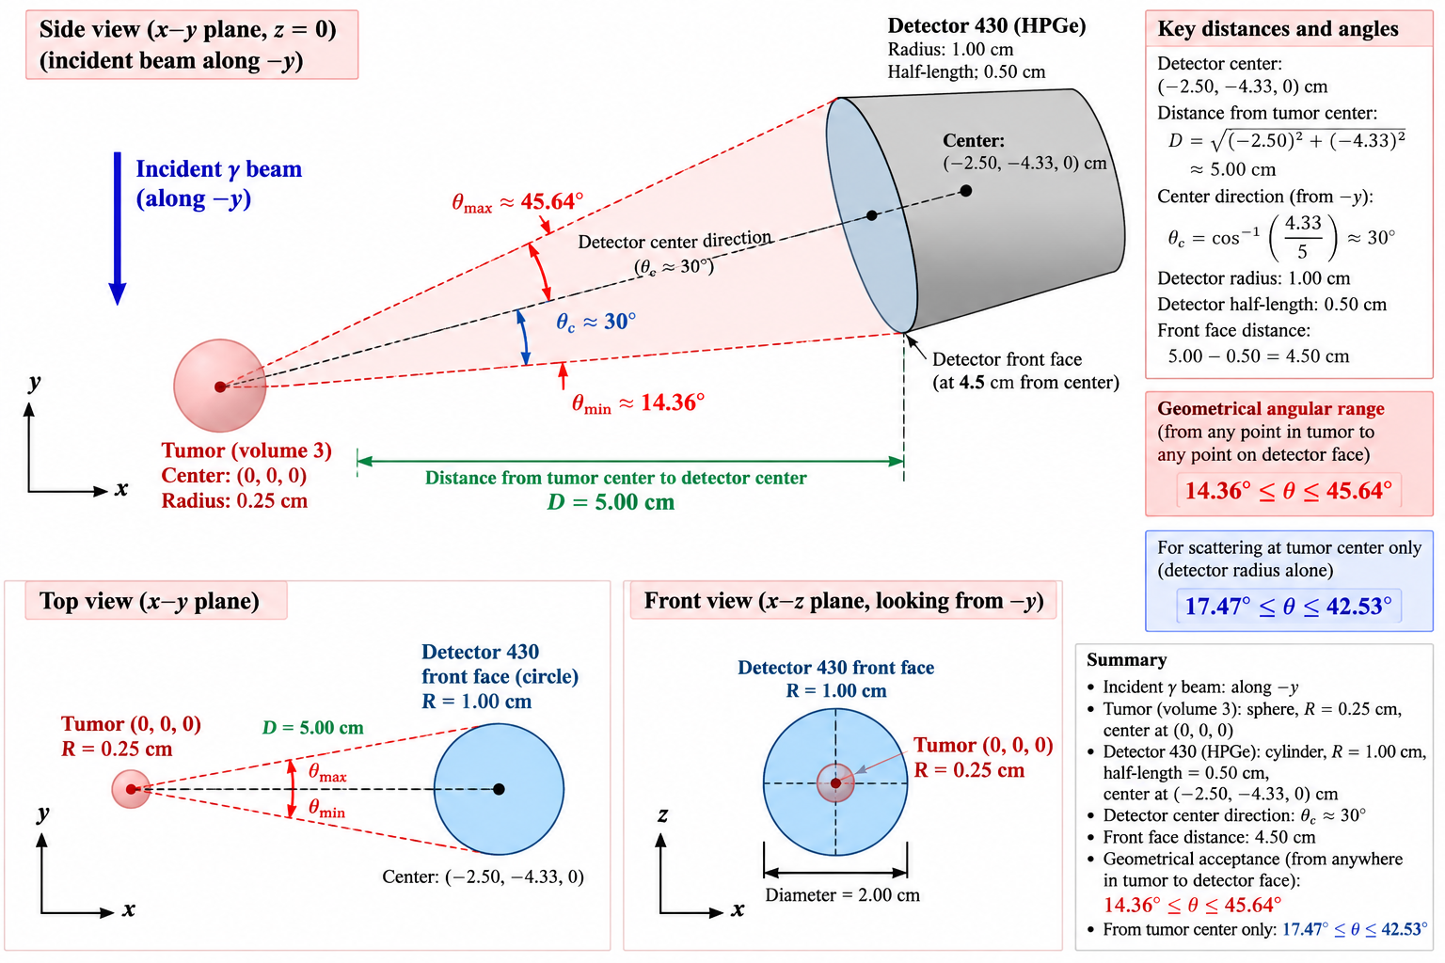
Ranges of Scattering Angle

Slide 3

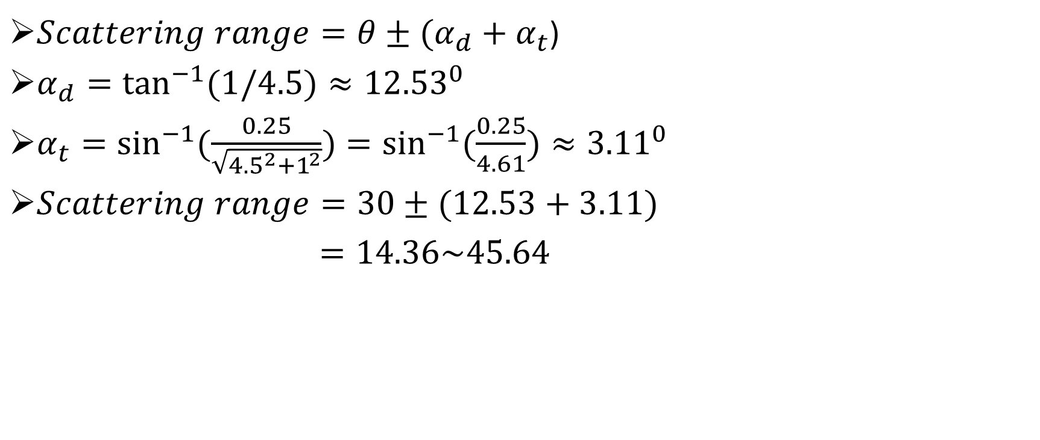


$Scattering range=θ±(α_{d}+α_{t}$)
$α_{d}=\tan^{−1}{(1/4.5)}≈{12.53}^{0}$
$α_{t}=\sin^{−1}{(\frac{0.25}{\sqrt{{4.5}^{2}+1^{2}}})}=\sin^{−1}{(\frac{0.25}{4.61})}≈{3.11}^{0}$
$Scattering range=30±(12.53+3.11)$
$=14.36\sim 45.64$
$$θ$$
4.5 cm
Incident beam
$$α_{d}$$
4.61 cm
1cm
$$α_{t}$$

Slide 4
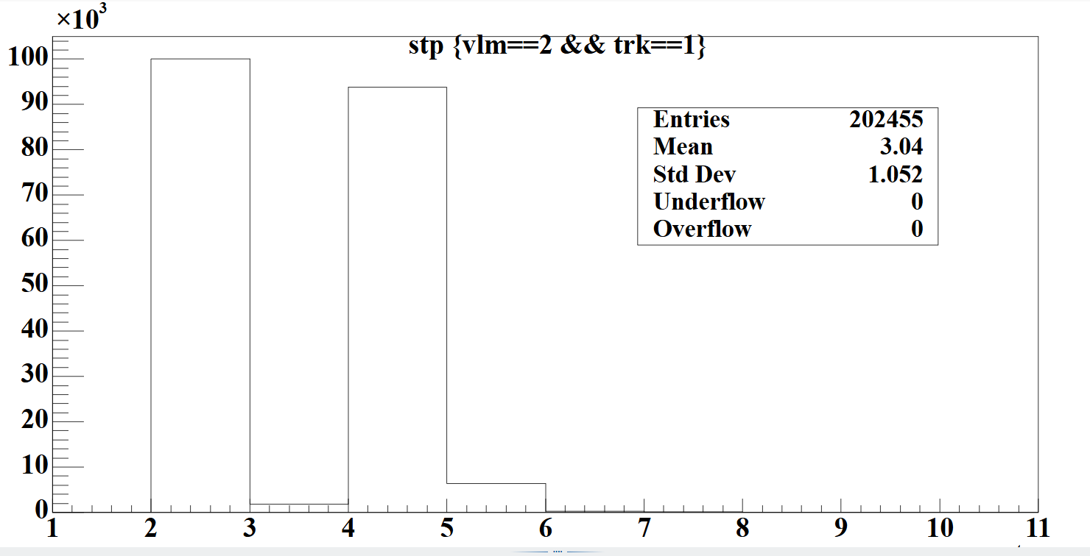
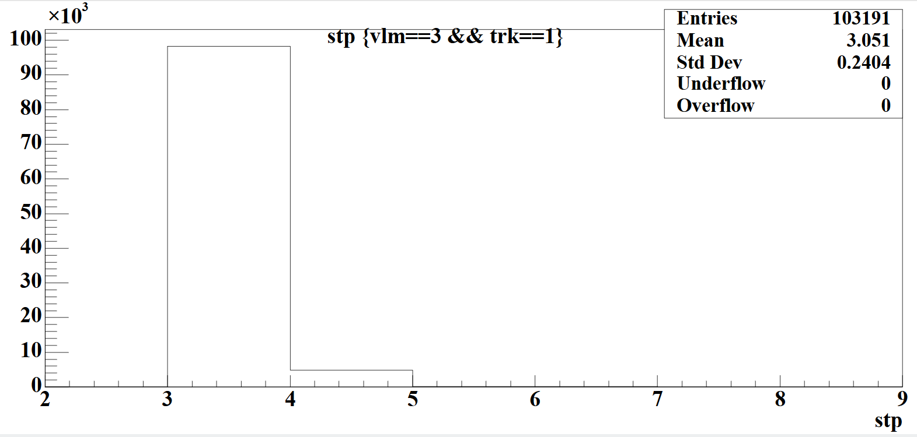
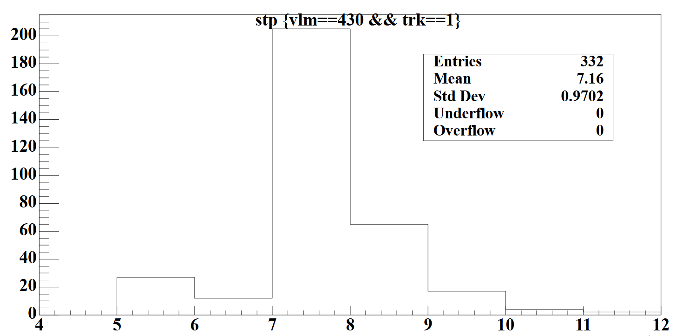
Scattering Events

Slide 5
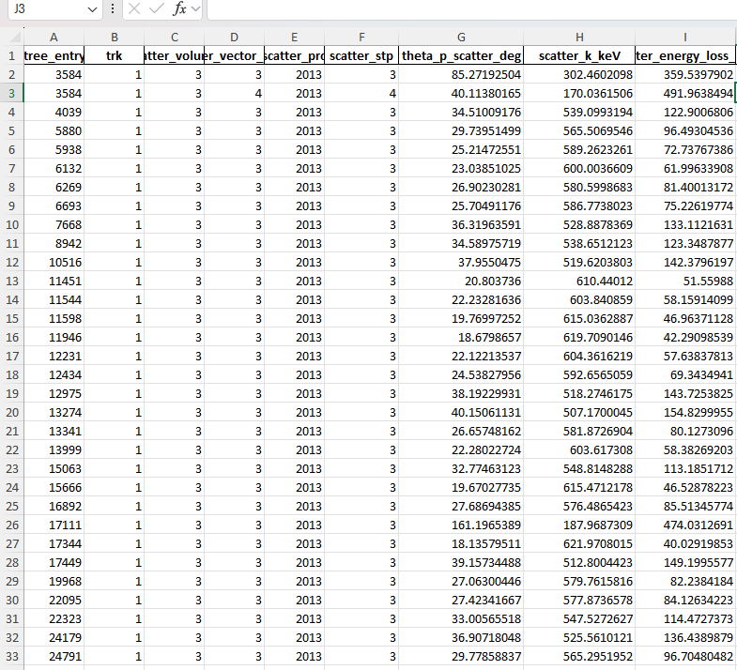
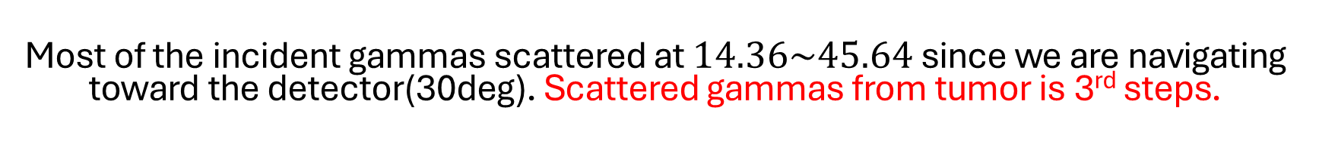
Compton Scattering from Tumor
Most of the incident gammas scattered at $14.36\sim 45.64$ since we are navigating toward the detector(30deg). Scattered gammas from tumor is 3rd steps.

Slide 6
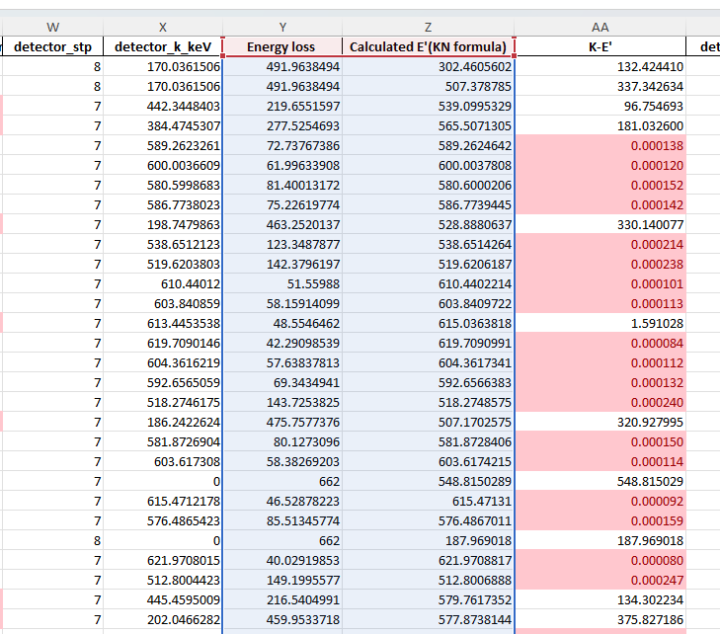
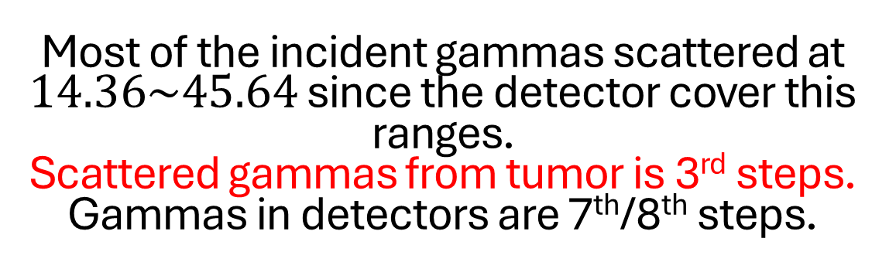
Most of the incident gammas scattered at $14.36\sim 45.64$ since the detector cover this ranges.
Scattered gammas from tumor is 3rd steps.
Gammas in detectors are 7th/8th steps.

Slide 7
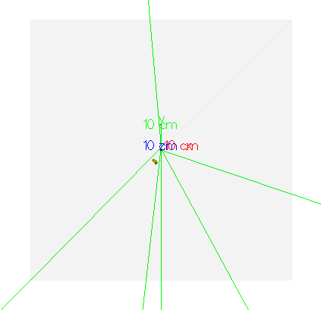
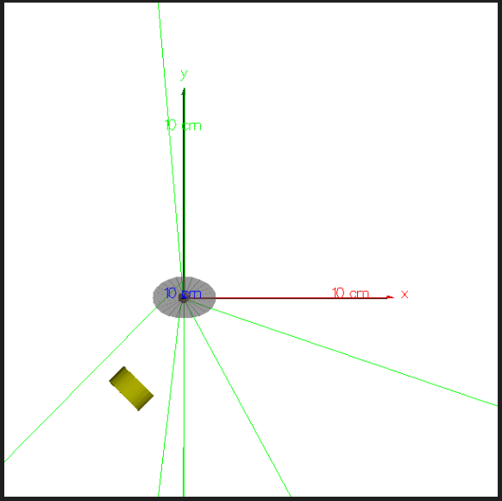
Is KN Formula Break down?
Why the single-scatter Compton formula breaks down here
The Compton (Klein-Nishina) energy-angle relationship is only valid for exactly one scattering event
There is extra energy loss somewhere inbetween the tumor and detector: either by additional Compton scattering (and/or other interactions).

Slide 8
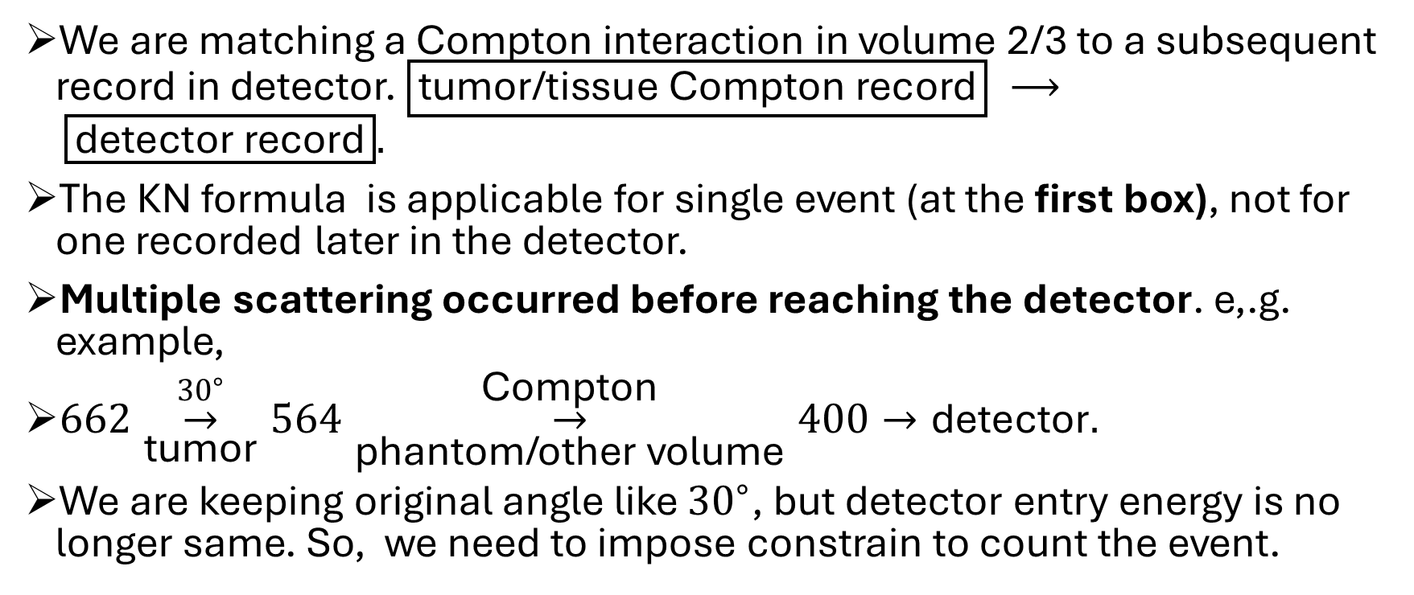
Is KN Formula Break down(con.)
We are matching a Compton interaction in volume 2/3 to a subsequent record in detector. $\boxed{\text{tumor/tissue Compton record}} ⟶ \boxed{\text{detector record}}.$
The KN formula is applicable for single event (at the first box), not for one recorded later in the detector.
Multiple scattering occurred before reaching the detector. e,.g. example,
$662\overset{{30}^{∘}}{\underset{\text{tumor}}{→}}564\overset{\text{Compton}}{\underset{\text{phantom/other volume}}{→}}400→\text{detector}.$
We are keeping original angle like ${30}^{∘}$, but detector entry energy is no longer same. So, we need to impose constrain to count the event.

Slide 9
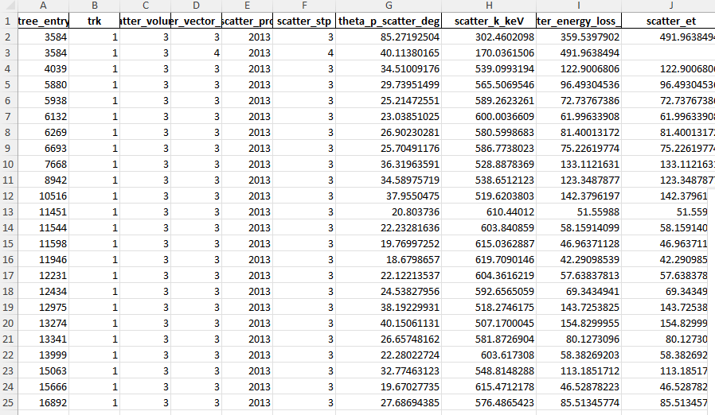
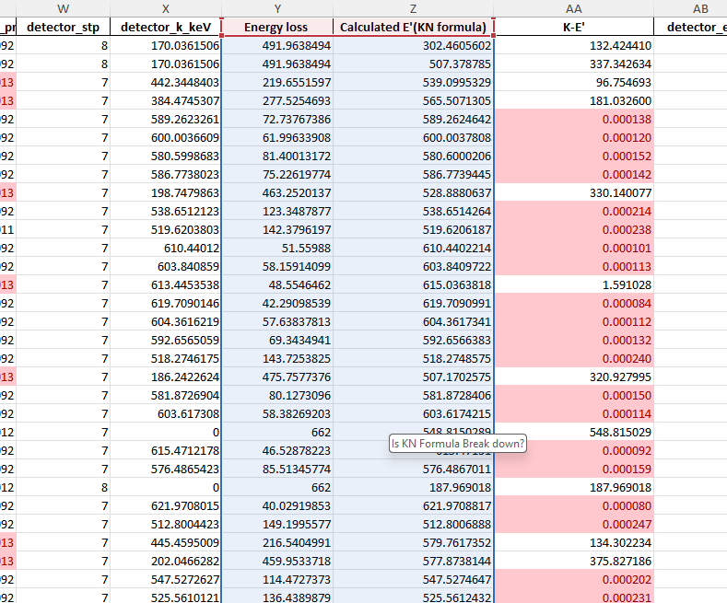
Overview
Geant4-ROOT- Excel
Compton profile mapping

